Slide 1

A Beginner’s Guide to MongoDB
Presented by Nicolas Erhardt

Slide 2
What is MongoDB?
MongoDB is a noSQL database- this means it is a Non-Relational database.
Does not require tables.
Data stored in documents as JSON objects.
No predefined data schema for data models- makes data flexible.
Data is entered in BSON (Binary JSON)- follows the exact same format as JSON, however, it is encoded in binary for increased efficiency.

Slide 3
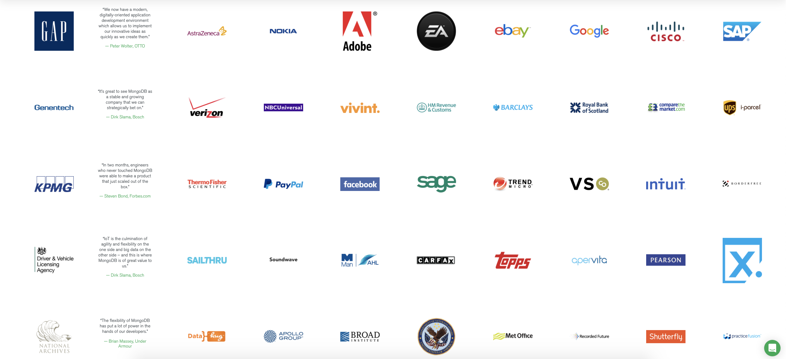
This is just a few examples of some of the many companies that use MongoDB.

Slide 4
How it works
Your MongoDB server can have multiple databases on it.
Within these databases you have collections- this is the part of the database we put our data into.
Data is stored in databases as documents.
Again, this data is schemaless- not every document has to have the same type of data.

Slide 5

How it works- example
Database
Happy’s Book Shop Financial Data
Collections
Income
Expenses
Documents
{month: ‘January’, book sales: 3500, magazine sales: 2000}
{month: ‘January’, shipping costs: 750, overhead costs: 250}
{month: ‘February’, book sales: 3500}
{month: ‘February’, shipping costs: 750}
Notice the how the month of February is missing data points in both the Income and Expenses collections- this is ok in MongoDB since the data is schemaless

Slide 6
Question- is MongoDB a shell, an app, or a web app?
Answer: it’s all three- MongoDB can be used as a shell in your terminal (Mac OS)/Command Prompt (Windows), as a web application using Mongo Atlas, or it can be utilized with MongoDB Compass.

Slide 7
Creating your database
Creating a new database on MongoDB is simple.
You can create an account for free, and you can even create multiple databases and utilize MongoDB’s many apps and web services for free.
Shared database clusters with up to 512 MB of storage are free- bigger shared databases and dedicated clusters cost money, and vary in price based on storage, RAM, etc.
Once you create your cluster, you can connect to the cluster via the Shell in Terminal or Command Prompt, or on MongoDB Compass. This can be done via a given command or link provided in Atlas upon hitting the “Connect” button.

Slide 8
Entering data in MongoDB Shell
Data is entered in BSON- uses exact same syntax and format as JSON.
Data points are entered as Javascript objects.
In the shell, enter a single data entry utilizing db.<collection name>.insert(), or enter multiple entries using db.<collection name>.insertMany().
Upon entering data in MongoDB shell, it will populate in MongoDB Atlas and Compass as well.

Slide 9
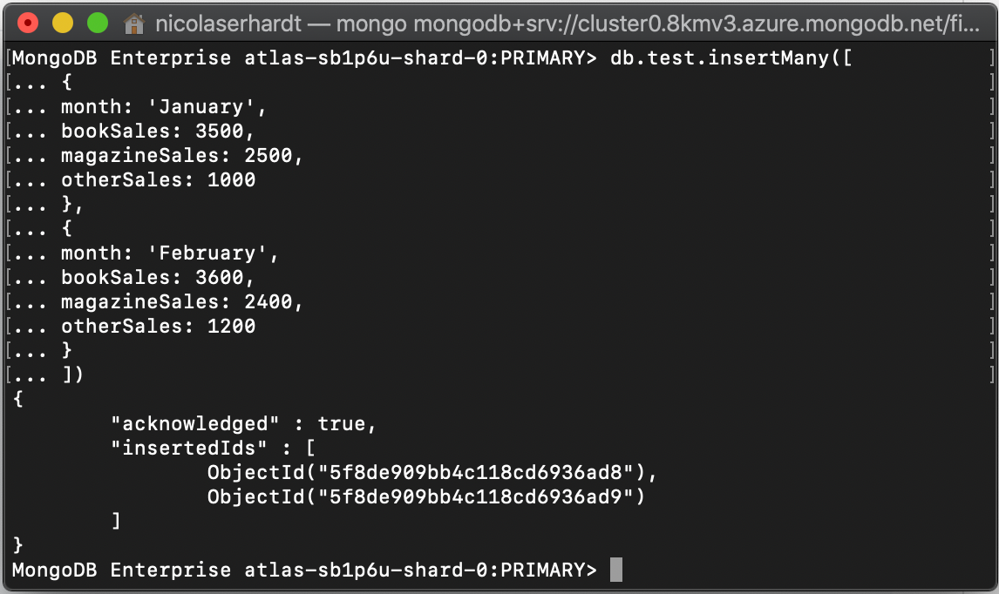
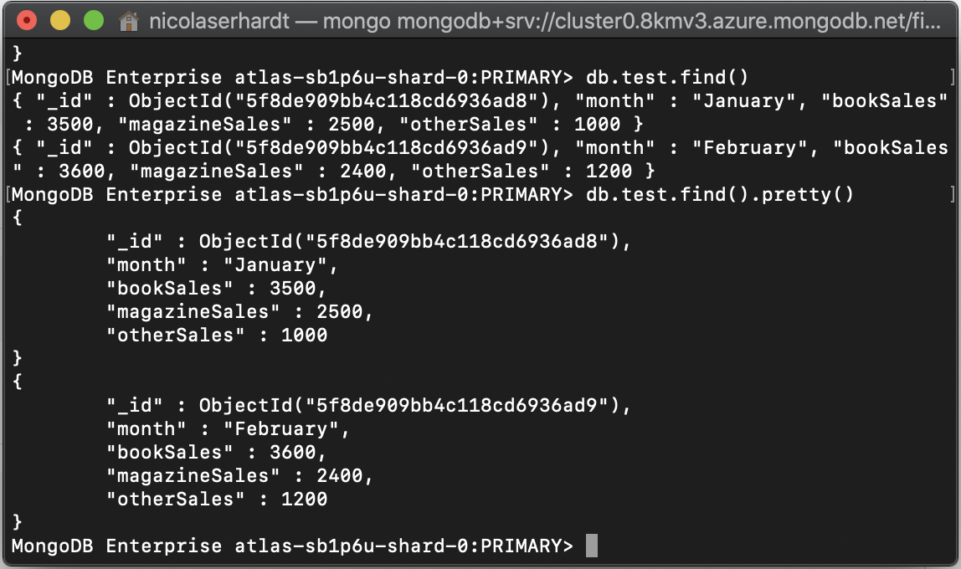
This Terminal window shows how one would enter multiple datapoints. In this case, we are entering financial data in a collection titled “test”.
Entering data in MongoDB shell- example
This terminal window shows two ways you can fetch data en masse- db.<collectionname>.find() displays the data in a condensed area, while db.<collection name>.find().pretty() cleans up the data and displays it in a more easy-to-read manner.

Slide 10
Entering data in MongoDB Atlas and MongoDB Compass
Data can be entered one of two ways in MongoDB Compass via the “add data” button: either by pasting JSON documents into the database, or by uploading a CSV or JSON file containing the data you would like to add.
In MongoDB Atlas, data can be inserted via ”insert document” button, and either a pre-formatted JSON object can be used to populate data, or the user can insert a JSON document themselves.

Slide 11
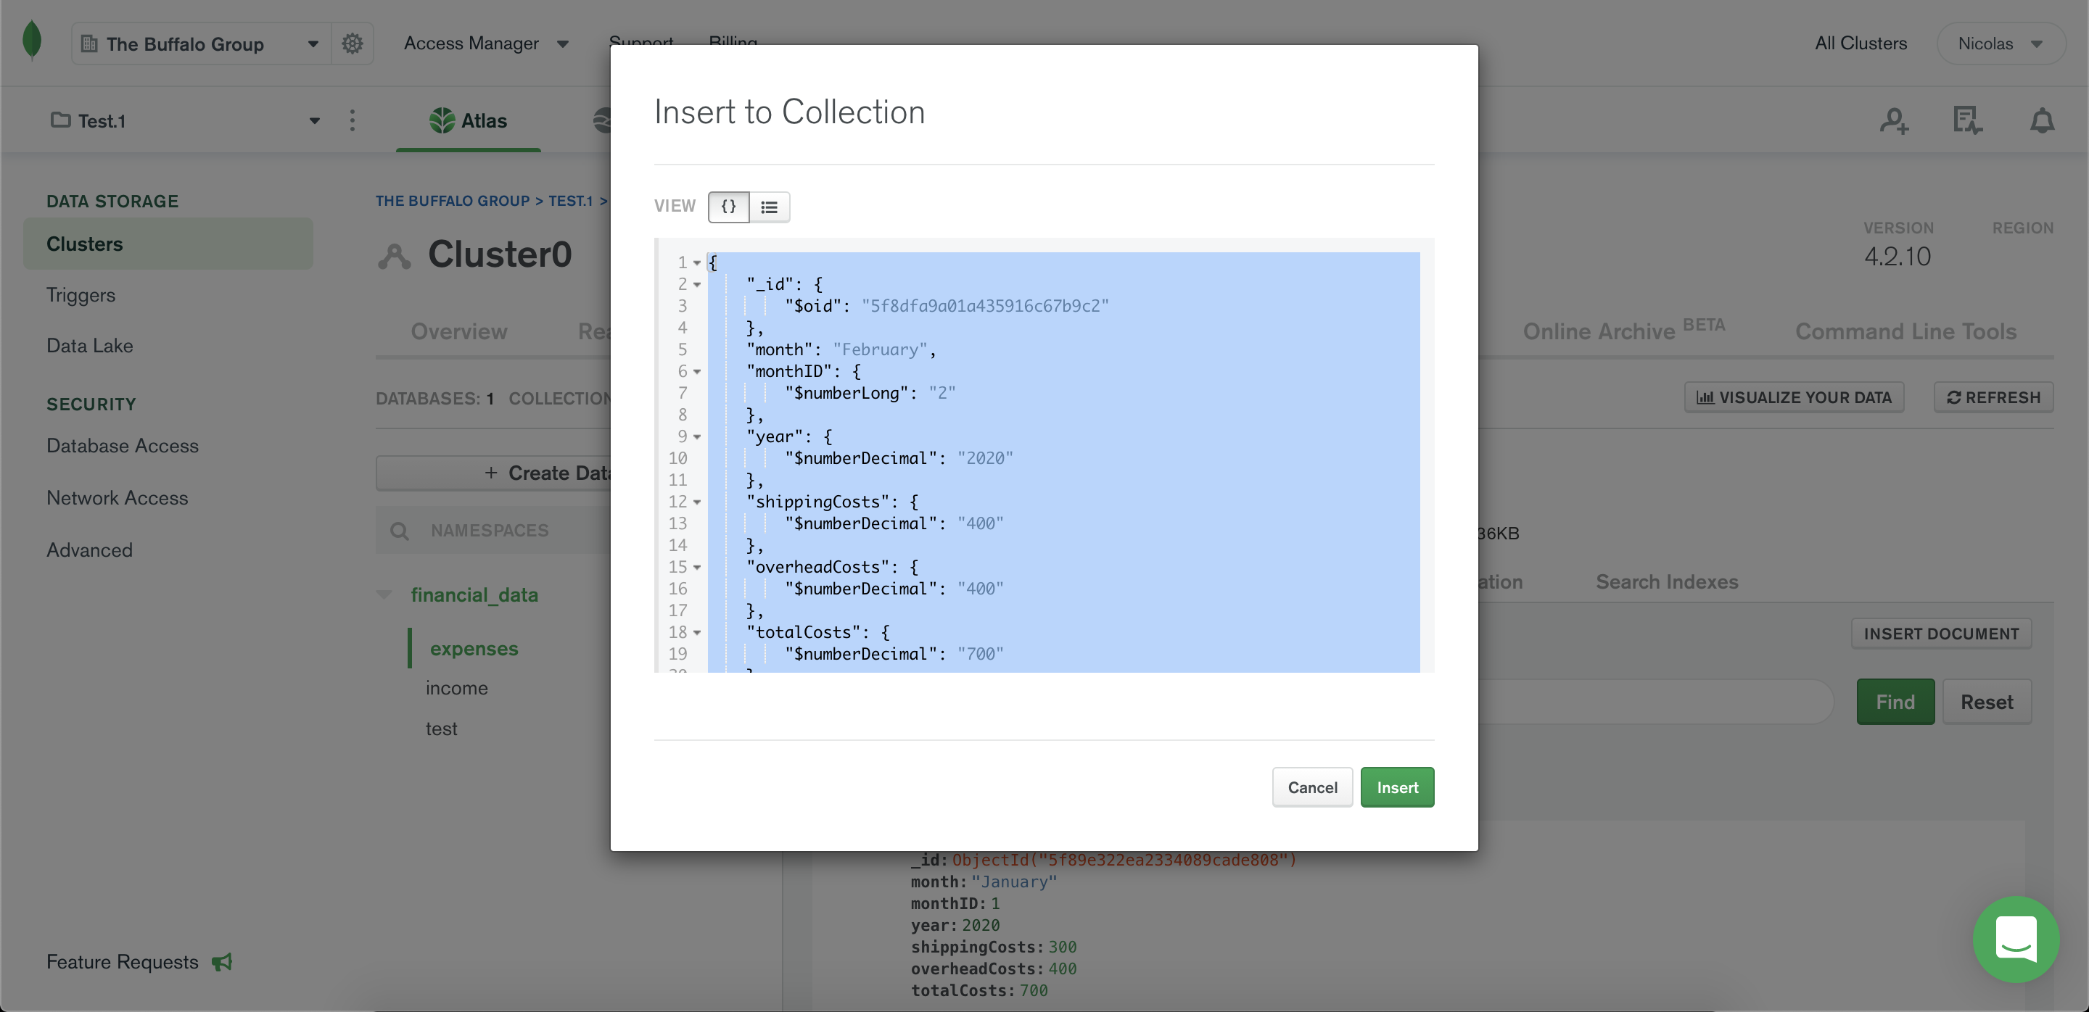
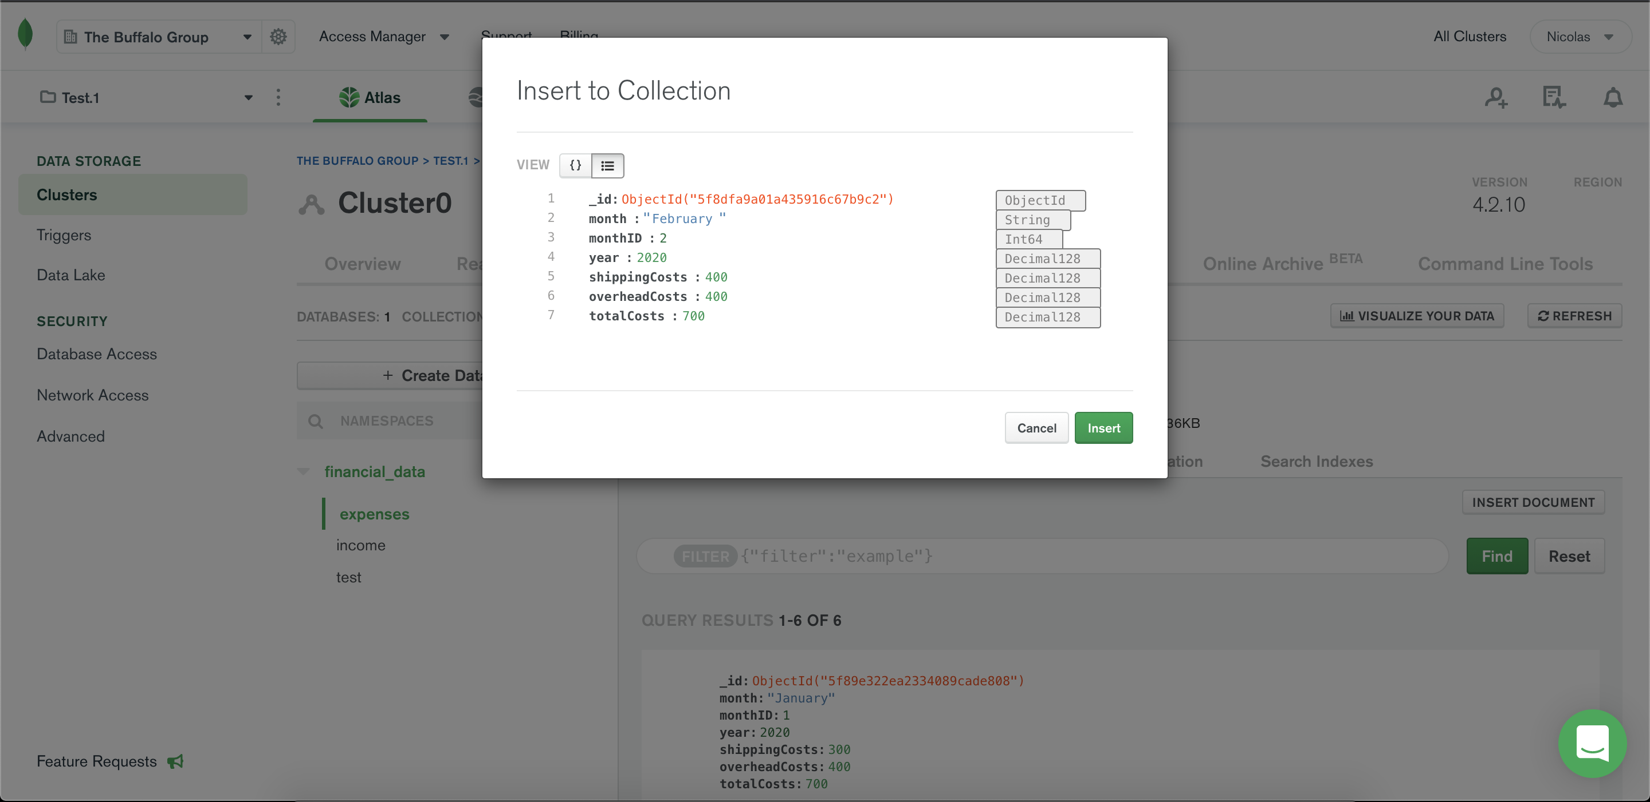
Entering data in MongoDB Atlas- example
In MongoDB Atlas, you have the option of entering JSON text in a terminal-like screen (top picture) or entering the text in a pre-formatted JSON object (bottom picture).

Slide 12
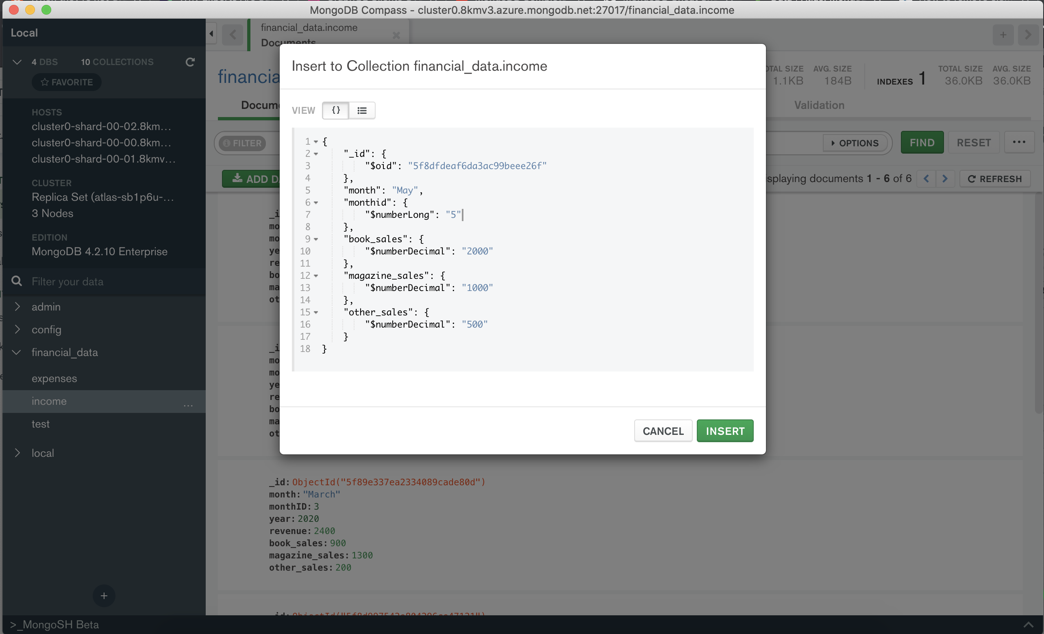
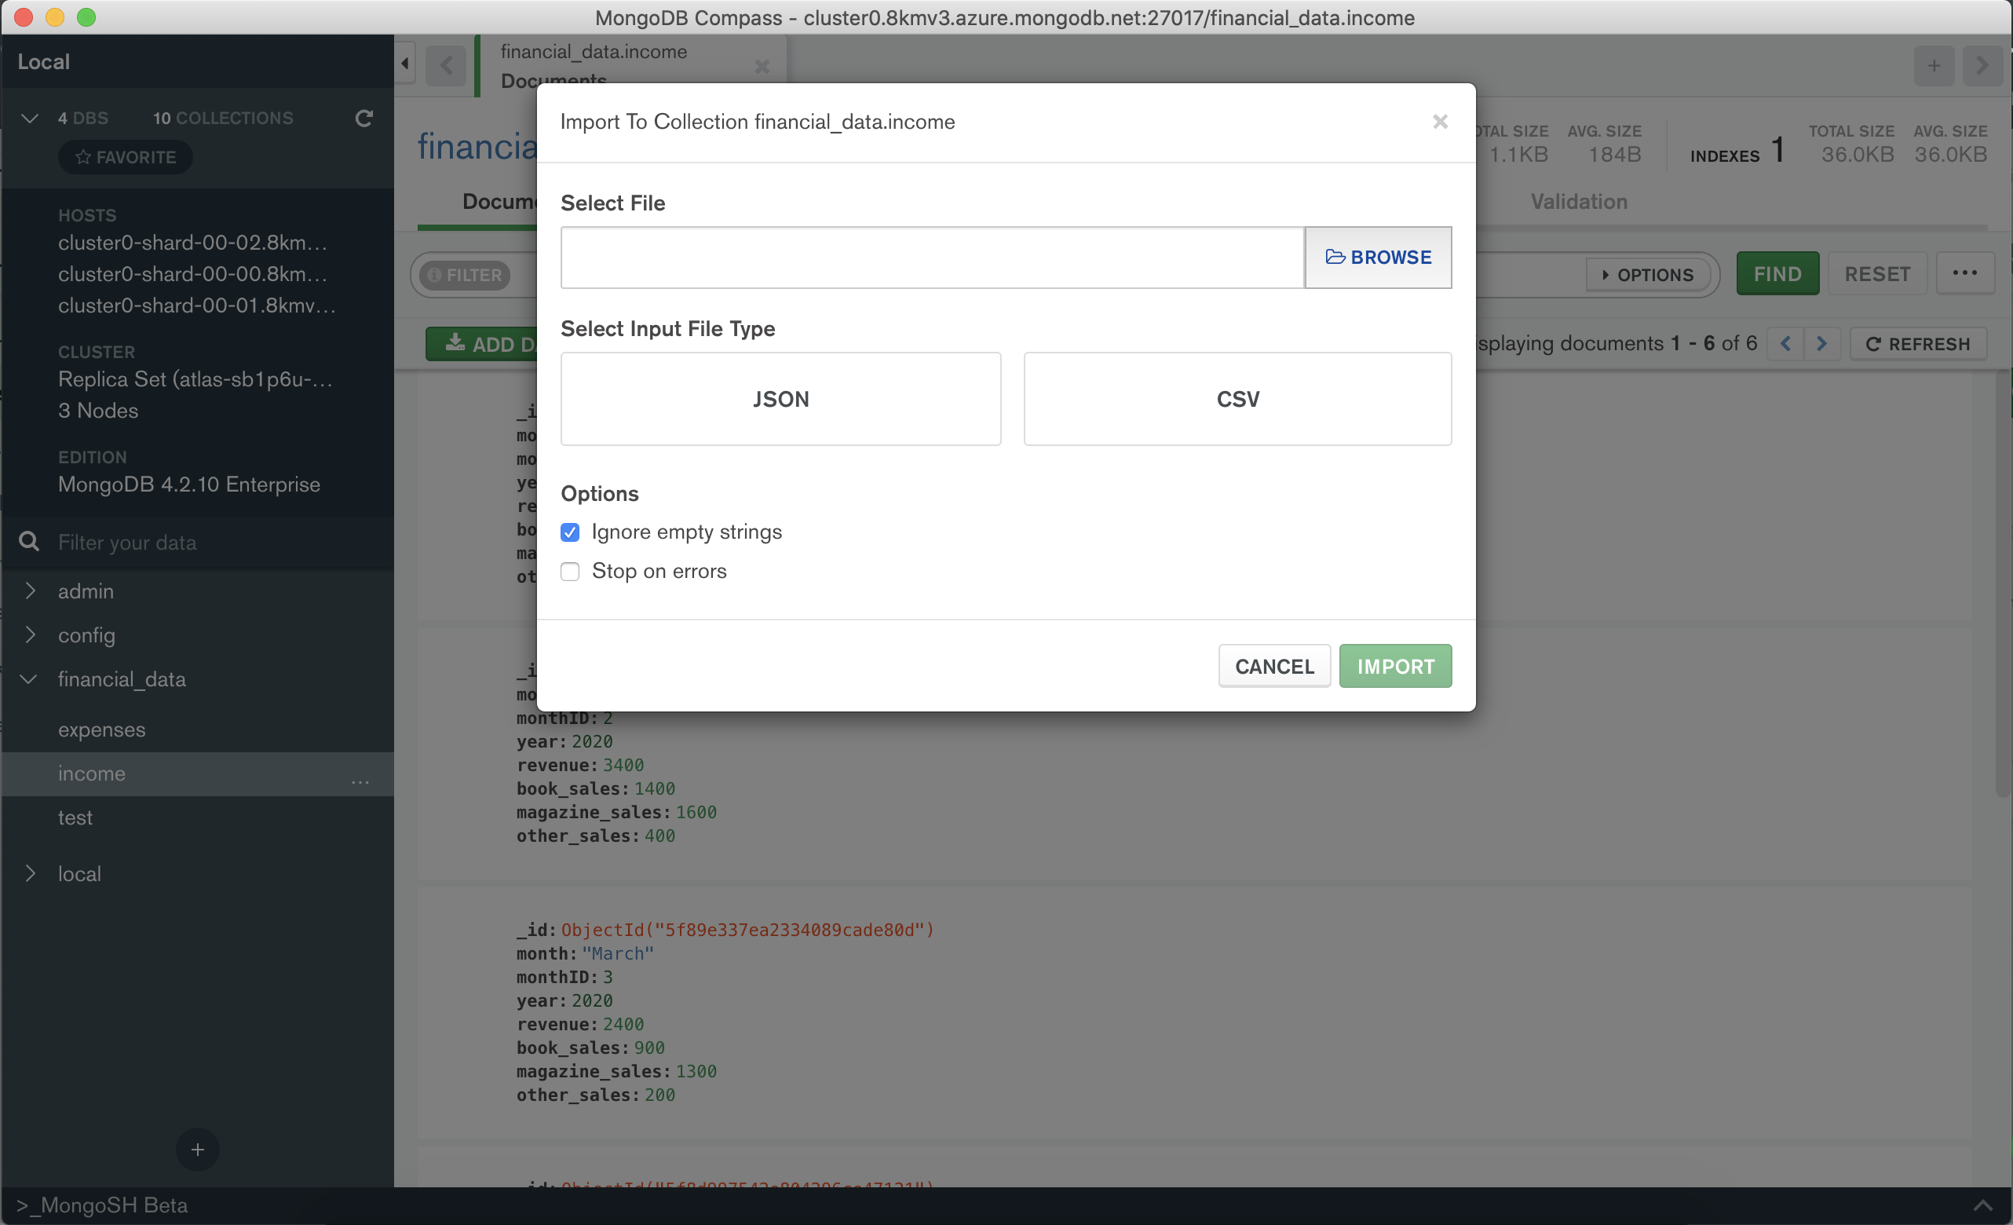
Entering data in MongoDB Compass- example
In MongoDB Compass, you can add data by either pasting a JSON document or uploading a CSV or JSON file. Both screens can be navigated to via the “add document” button.

Slide 13
You have data… now what?
It’s time to visualize it.
We can visualize the data in MongoDB Charts.
Charts in your dashboard can be updated in real time- as you enter data in MongoDB Atlas, Compass, or the shell, the charts will update.
You can also filter data in MongoDB Charts, showing only data you want to see laid out in a specified chart format (e.g. data for only Q2 of 2020).
Adding a chart is simple- just navigate to MongoDB Charts from Atlas and click on “Add Chart”.

Slide 14
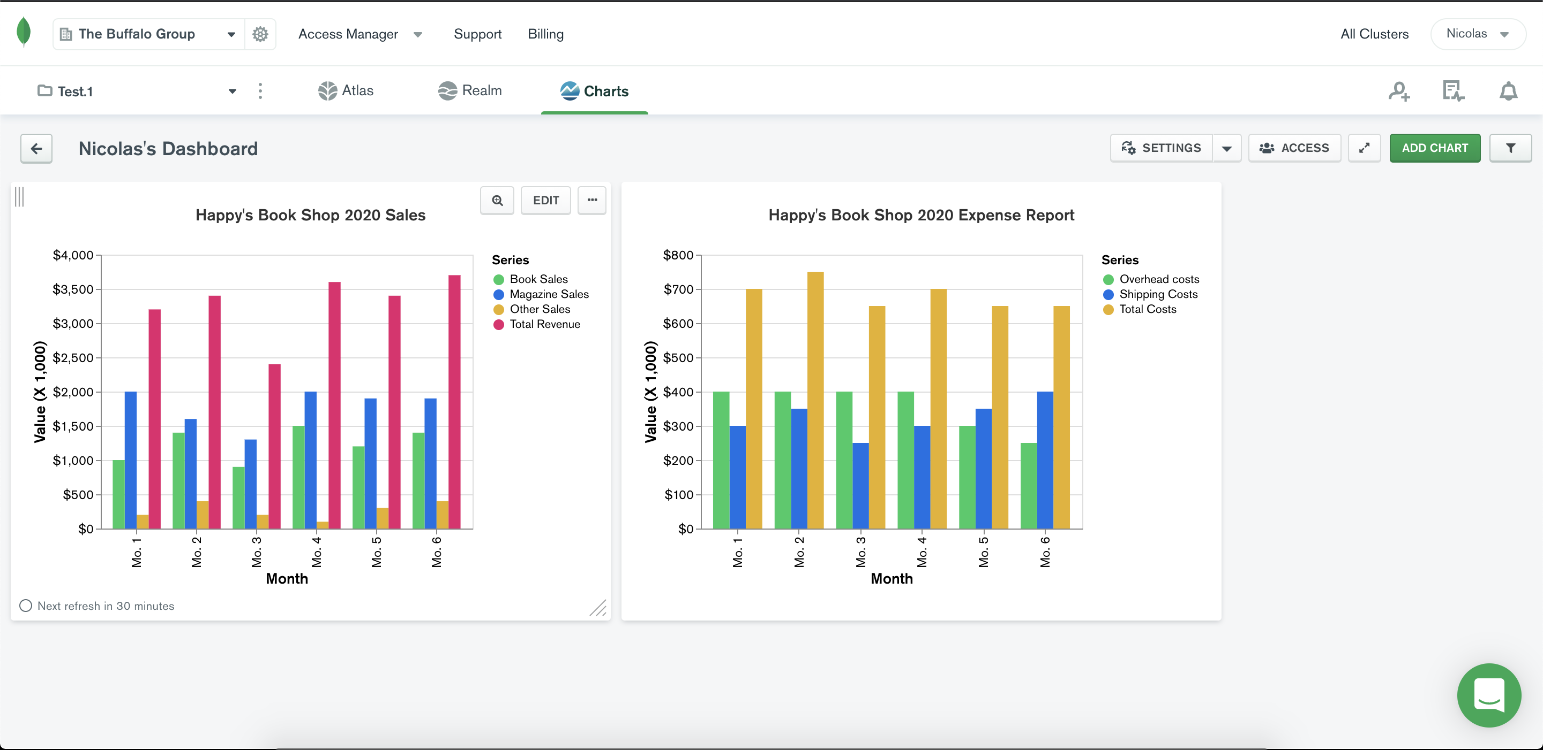
An example of a MongoDB Charts dashboard with charts created from our databases.

Slide 15
Going further
MongoDB has many more capabilities, including MongoDB Realm, which allows you to create applications that sync to your databases.
The possibilities with MongoDB are endless, however, the techniques you learned today will help you get started with the basics of MondoDB.
MongoDB offers multiple free online courses so that you can master their database service and optimize your business’ data storage.

Slide 16
Questions?

